Slide 1
Lunch and Learn Remember
Sometimes you will never know the value of a moment until it becomes a memory.
- Theodor Seuss Geisel

Slide 2
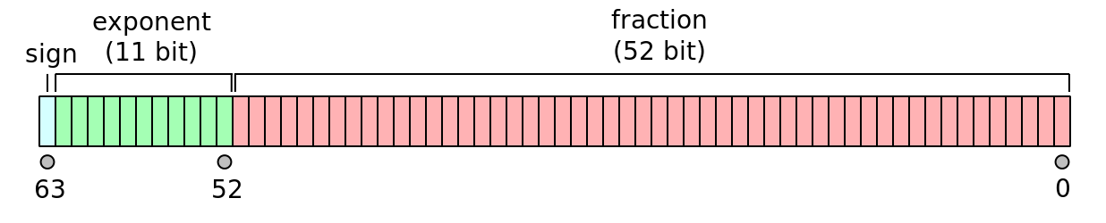
Fun Memory 1: IN JavaScript 1 is stored in 64 bits
00000000 0000 0000 0000 0000 0000 0000 0000 0000 0000 0000 0000 0000 0000 0001
while in fact, double precision floats (IEEE-754):
0 01111111111 0000000000000000000000000000000000000000000000000000
sign exponent (11 bits) mantissa (52 bits)
K = 2 ^{n-1} – 1

Slide 3
Fun Memory 1 (cont.…)
in Java/C++: for ( int index = 1; 1/index > 0; index++ ) { System.out.println("Count is: " + index); }
in JavaScript/node, the same program with interesting behavior
for (let index = 1; 1/index > 0; index++) { console.log(‘Count is: ‘, index) } 1/i is not evaluated as integer, but as a floating point

Slide 4
Fun memory II (middle school)
Can you explain it to a sixth grader?
The Sin of Dividing by Zero – that such a taboo exists! Ok let’s explain ….
6
0.1 => 0.001 => 0.000 001 => 0.000 000 000 001 => 0.000 000 000 000 000 000 000 001 The faint of heart say the answer is undefined, but the truth is it’s infinite!

Slide 5
Algorithm Types
Algorithm types:
Simple recursive algorithms
Backtracking algorithms
Divide and conquer algorithms (breaking down a problem into two or more sub-problems of the same or related type)
Greedy algorithms (locally optimal choice at each stage with the intent of finding a global optimum
Branch and bound algorithms (combinatorial, mathematical optimization problems)
Dynamic programming algorithms
Randomized algorithms (Monte Carlo, Las Vegas )
Brute force algorithms

Slide 6
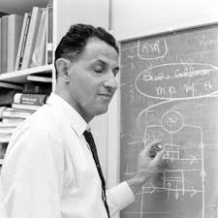
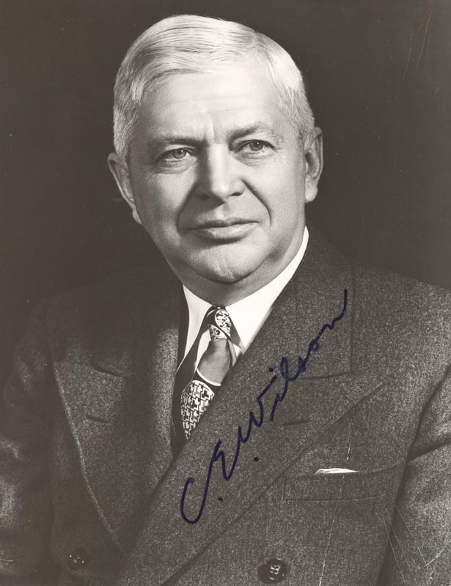

Brief History: ON THE BIRTH OF DYNAMIC PROGRAMMING
Applied Mathematician
Sec. of Defense (1953 – ‘57)
Richard Bellman (1920-’84)
Charles Erwin Wilson
“The 1950s were not good years for mathematical research. We had a very interesting gentleman in Washington named Wilson. He was Secretary of Defense, and he actually had a pathological fear and hatred of the word, research. His face would suffuse, he would turn red, and he would get violent if people used the term, research, in his presence. You can imagine how he felt, then, about the term, mathematical. I thought dynamic programming was a good name. It was something not even a Congressman could object to.”

Slide 7
What is DP and Real life Application
The “diff” utility in Unix
To find patterns in DNA
Routing algorithms in Maps Software and Networking (Dijkstra, Bellman-Ford)
Forecasting market demand (Volatility forecasting of market demand as aids for planning manufacturing activities)
Spelling correction (Lowenstein)
Energy-efficient scheduling of Power Stations
Speech recognition (Viterbi algorithm, Dynamic time warping)
Database query optimization (Selinger algorithm)
"Did you mean ... ?" feature in search engines
CYK algorithm (parsing algorithm for context-free grammars)
and more ...

Slide 8
Dynamic programming vs greedy method
Both are used for optimization method, both have different strategies but the purpose is the same.
Optimization problem are those which require minimum or maximum result
In GREEDY method we try to follow PREDEFINED procedure to get the optimal result. And the procedure is KNOWN to get the optimal. Example: Kruskal's algorithm is a minimum-spanning-tree algorithm (always select the minimum edge and that gives us the best result) or Dijkstra’s shortest path algorithm. All are done with predefined solution
In DYNAMIC programming we explore all solution and pick the best solution
In DYNAMIC problems are solved with PRINCIPLE of OPTIMALITY (Bellman principle)
In GREEDY algorithms decisions are taken at onetime, in DYNAMIC programming in every stage we take optimal decision.

Slide 9
Principle of optimality
PRINCIPLE OF OPTIMALITY: This is the most important property a problem need to have in order to be eligible for dynamic programming solution.
Principle of Optimality states that in an optimal sequence of choices, each subsequence MUST also be optimal.

Slide 10
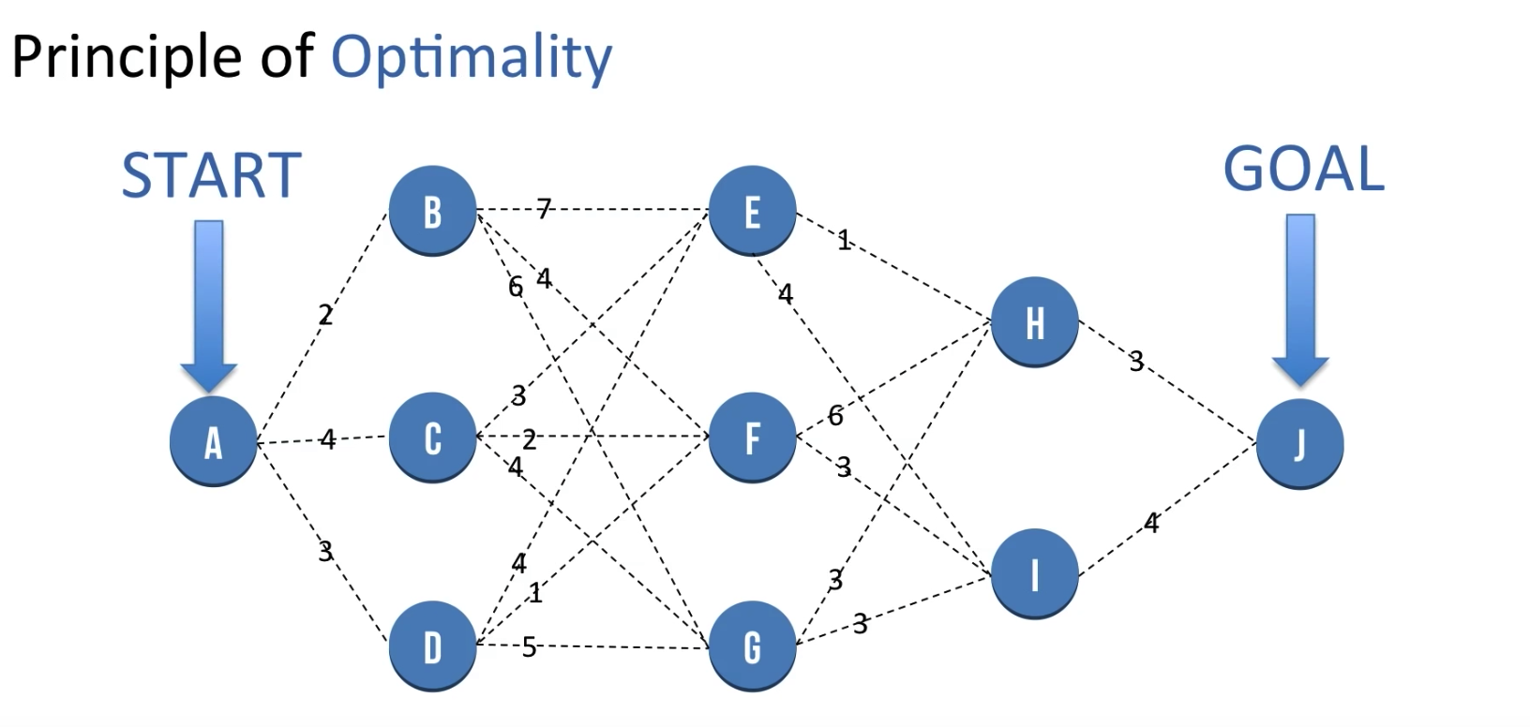
Principle of optimality

Slide 11
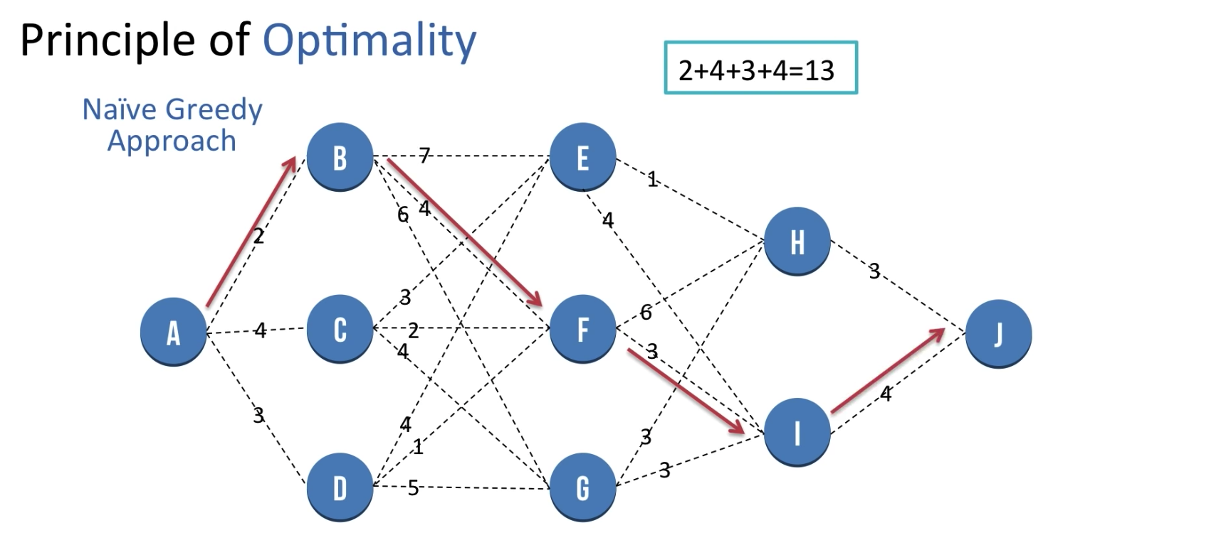

Slide 12
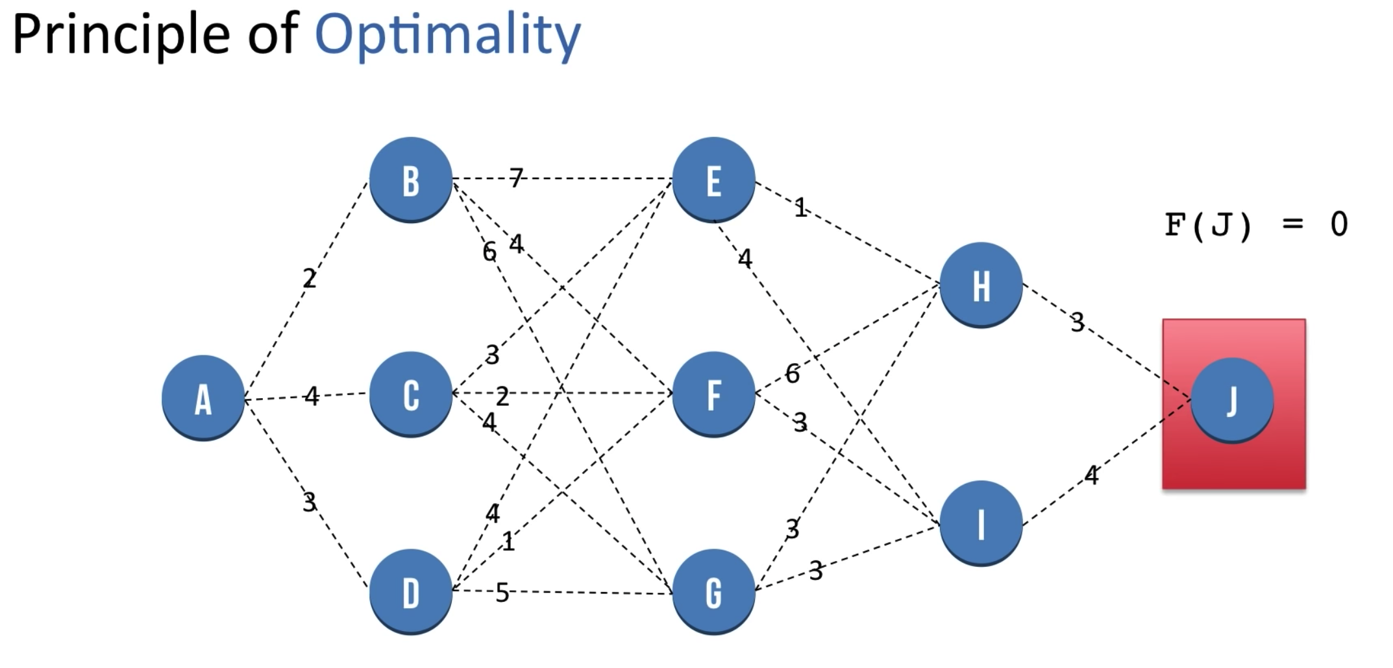
Let f(x) be the minimum distance to reach “j” from a node “x”

Slide 13
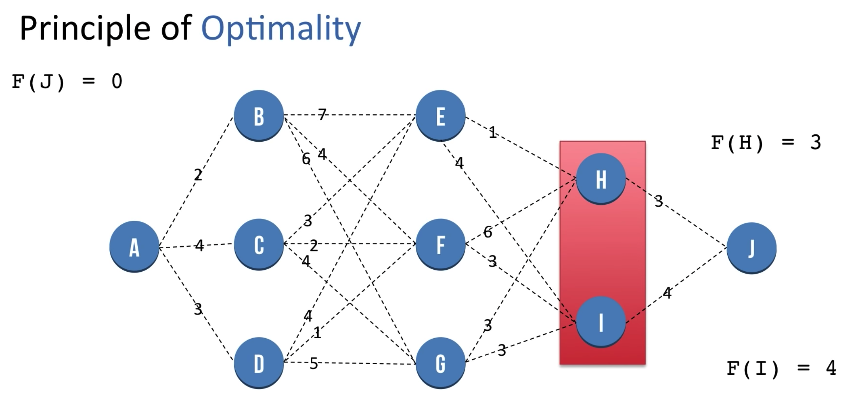

Slide 14
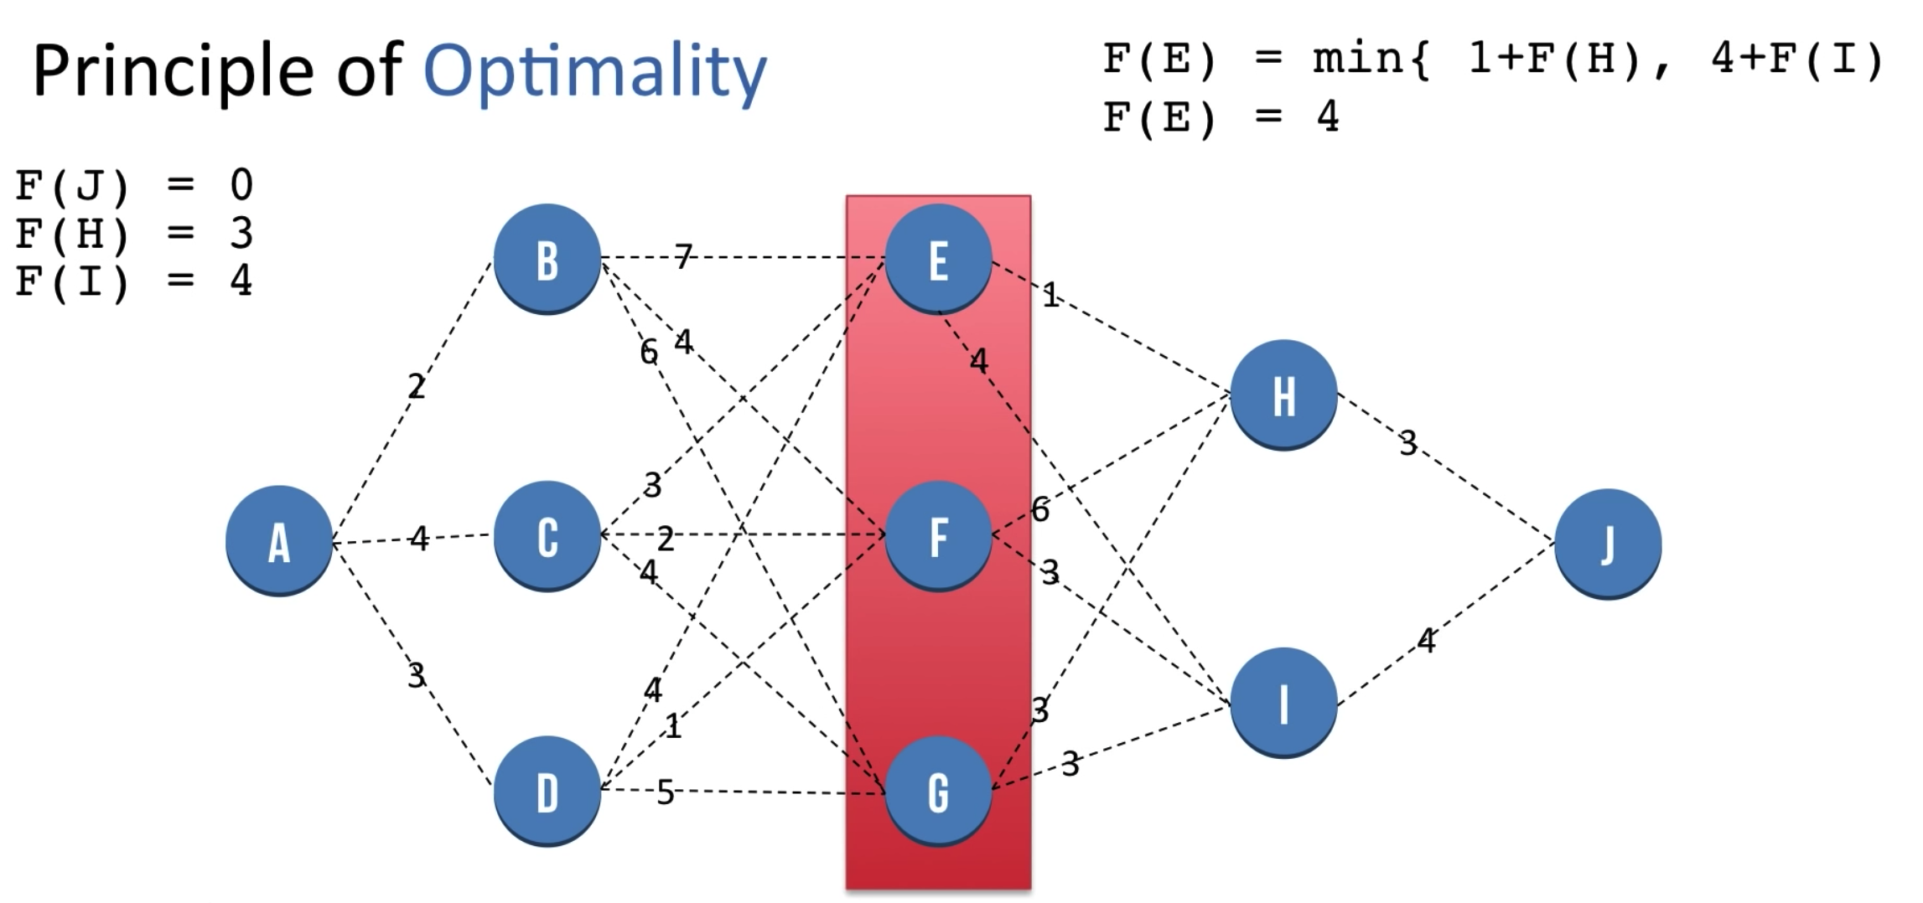

Slide 15
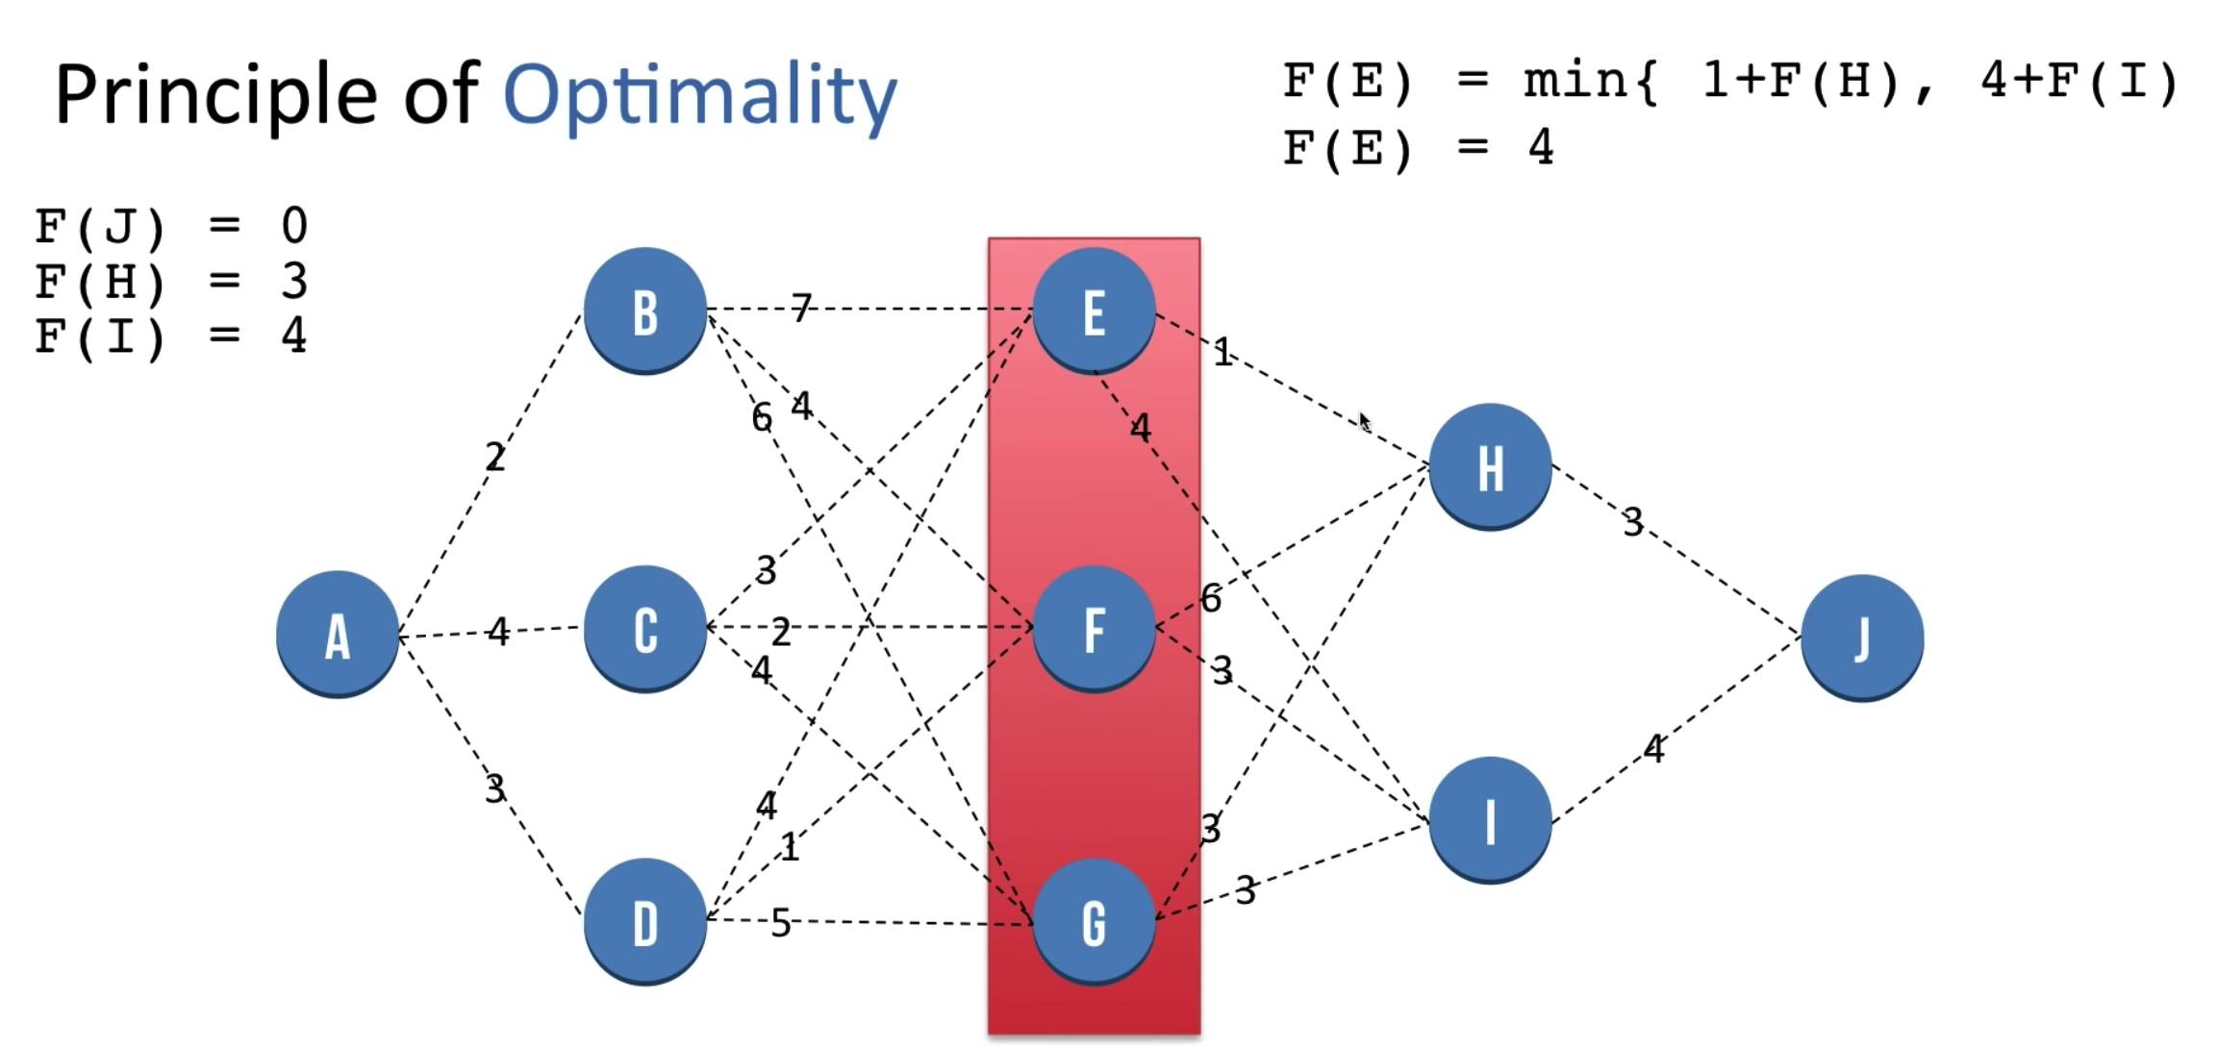

Slide 16
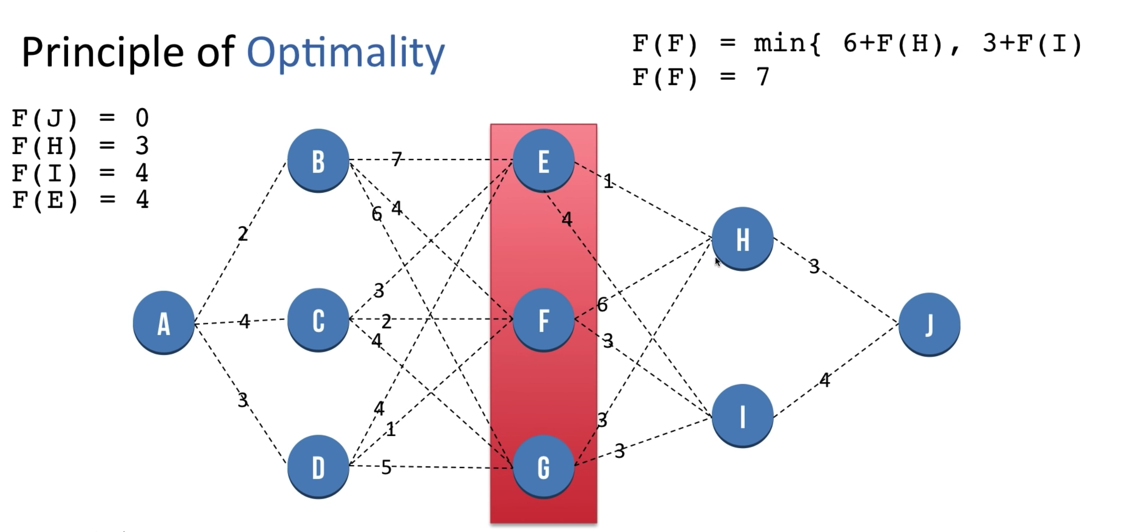

Slide 17
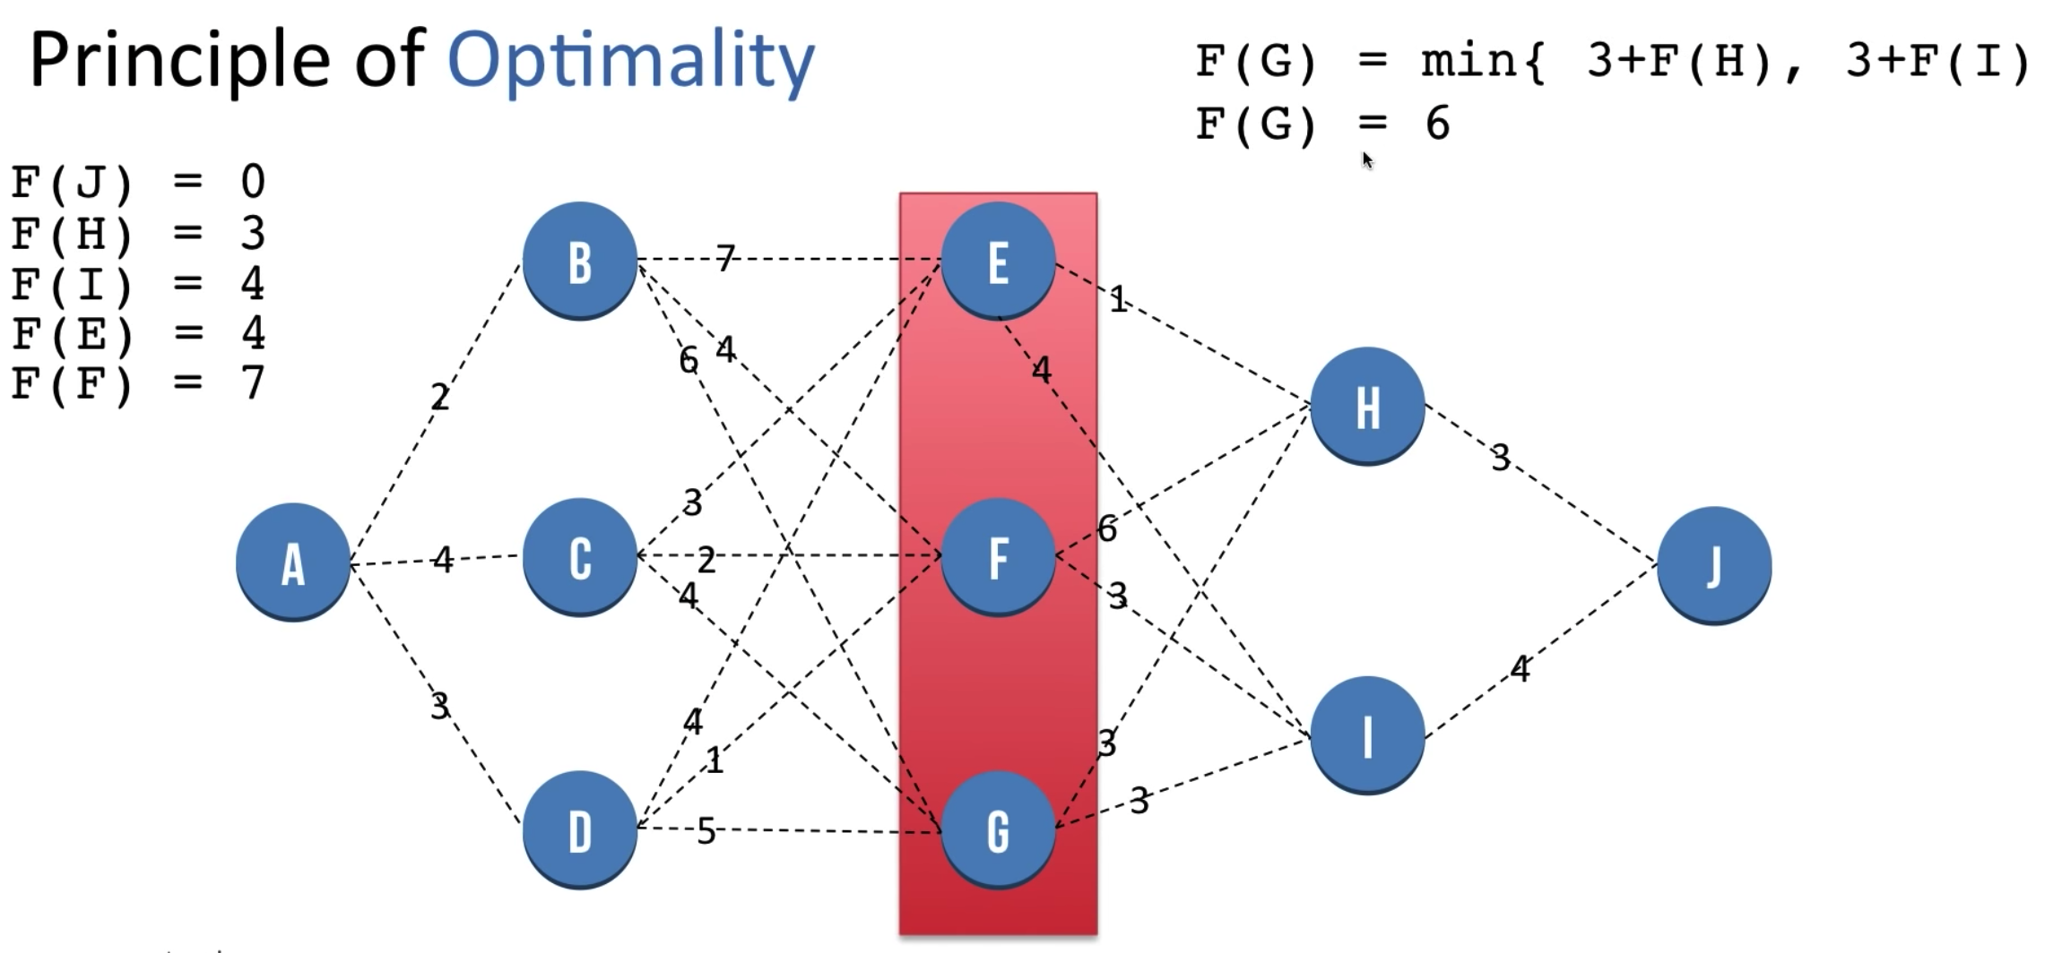

Slide 18
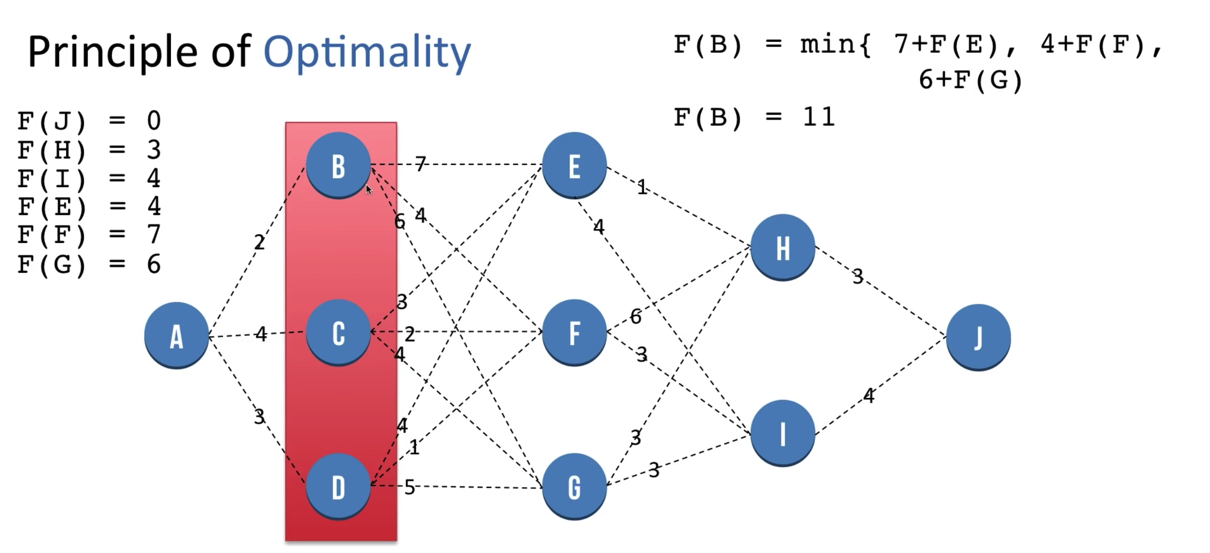

Slide 19
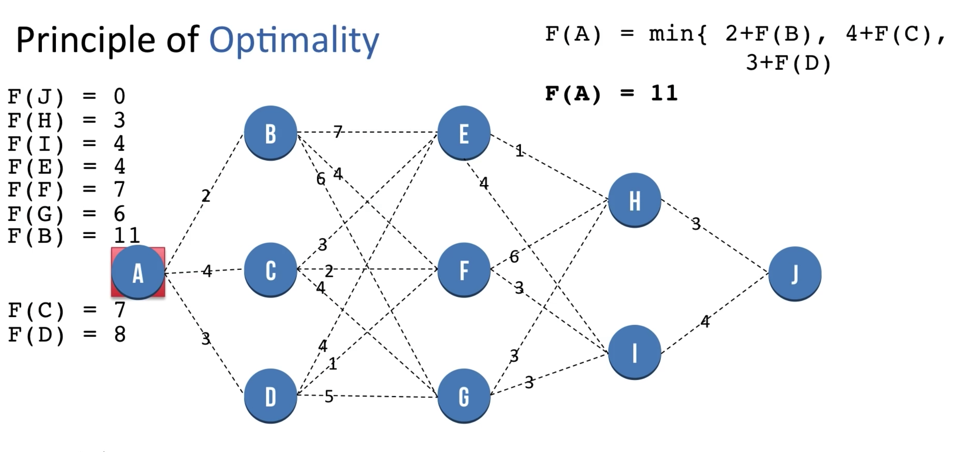

Slide 20
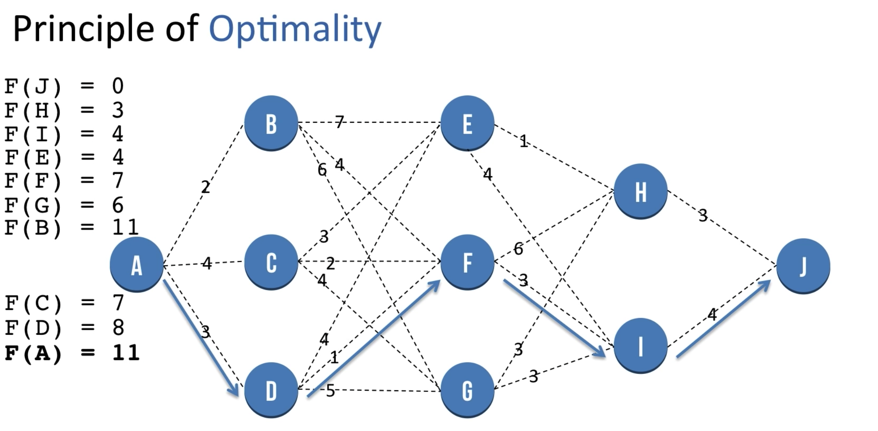

Slide 21
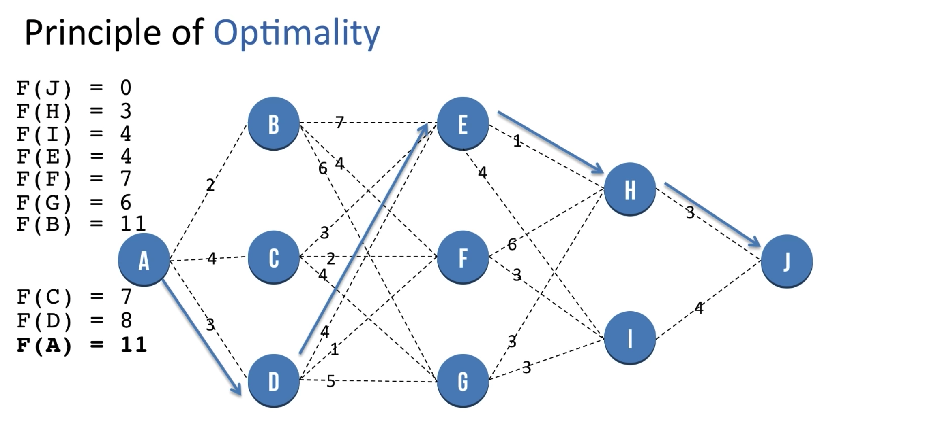

Slide 22
How to apply DP
Find the recursion in the problem, if the naive recursive algorithm does not compute the same subproblem multiple time, dynamic programming won't help
Top-down: store the answer for each subproblem in a table to avoid having to recompute them (memoization)
Bottom-up: Find the right order to evaluate the results so that partial results are available when needed.

Slide 23
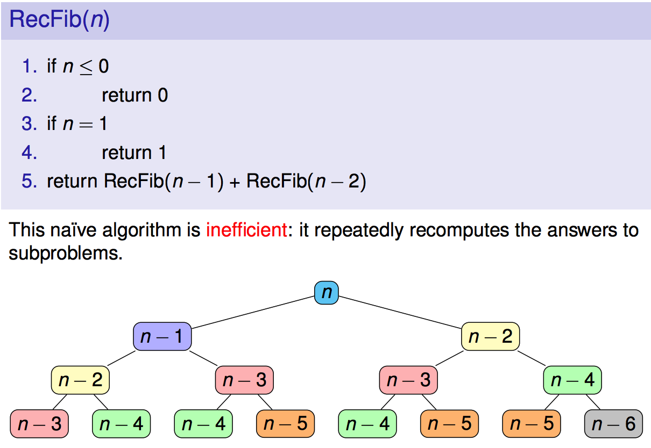
Memoization dynamic programming (dp)?
Dynamic programming (DP) is when you use past knowledge to make solving a future problem easier. DP is a way of finding efficient algorithms for problems which can be broken down into simpler, overlapping subproblems.

Slide 24
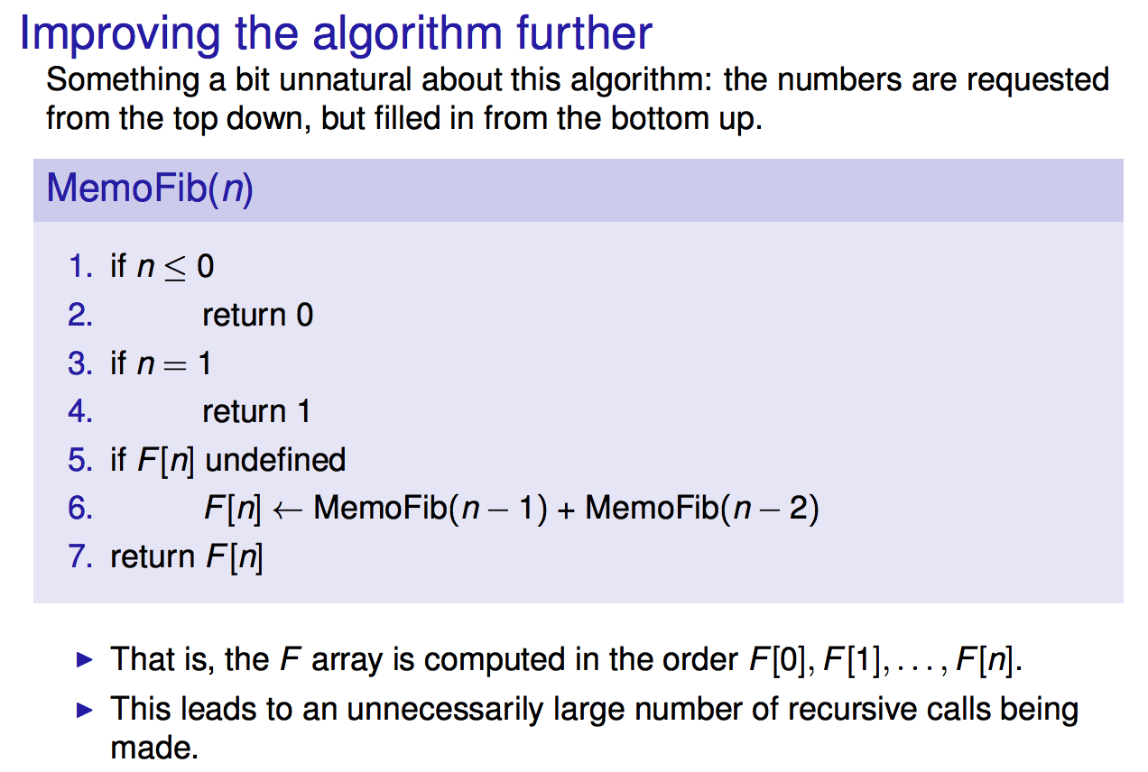

Slide 25
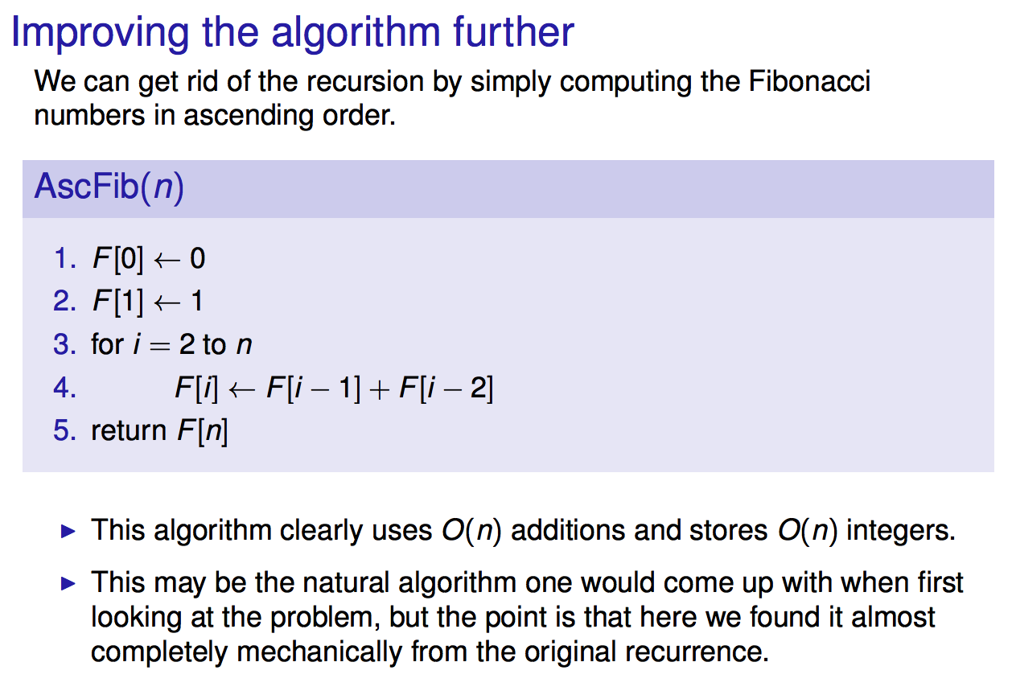

Slide 26
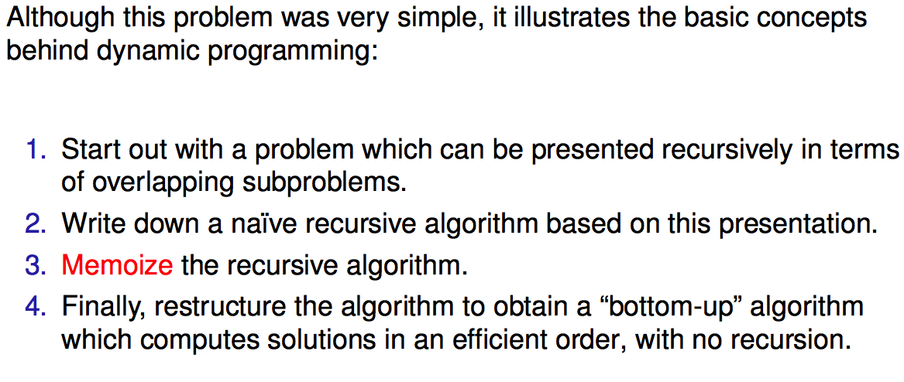

Slide 27
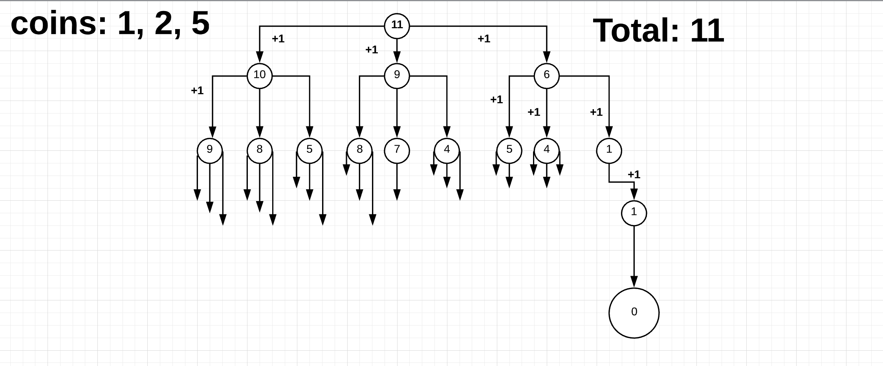
Example Coin change

Slide 28
Example: coin change (Min coins)
Coins: { 1, 2, 5 }
Amounts: 11
amount
0 | 1 | 2 | 3 | 4 | 5 | 6 | 7 | 8 | 9 | 10 | 11
0 | 1 | 1 | 2 | 2 | 1 | 2 | 2 | 3 | 3 | 2 | 3
coins
Min (_, _,_) + 1 example: for the amount of 5 5-5 = 0 => 0 5-2 = 3 => 2 5-1 = 4 => 2 min (0, 2, 2) = 0 + 1 = 1

Slide 29
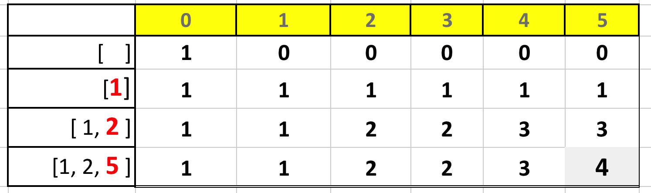
Total Unique Way to Change Coins
amount = 5, coins = [ 1, 2, 5]
A[ i, j ] = A[ i-1, j ] + A[ i ] [ j - coins [ i ] ]
(1). exclude the coin (2). include the coin Add (1) + (2)
0
1
2
if ( coins[ i ] > j ) A[ i, j ] = A[ i-1, j ] else A[ i, j ] = A[ i-1, j ] + A[ i, j – coins[i] ]

Slide 30
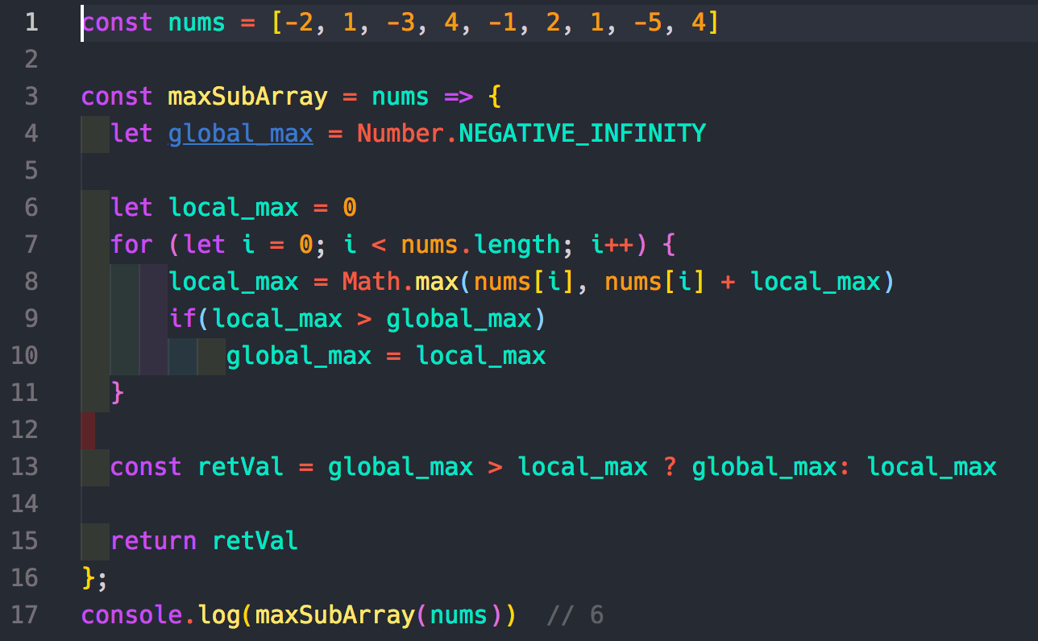
Largest Sum Contiguous Subarray

Slide 31
Appendix: Bits pattern
The bits pattern of a stored number
const to64bitFloat = (number) => {
let i = 0, result = '';
let daraView = new DataView(new ArrayBuffer(8));
daraView.setFloat64(0, number, false);
while (i < 8) {
let bits = daraView.getUint8(i).toString(2);
if (bits.length < 8) {
bits = new Array(8 - bits.length).fill('0').join('') + bits;
}
result = result.concat(bits);
i++
}
return result;
}

